Slide 1
Hosting Audio Unit Extensions

Slide 2
Overview
Refer to AU v3 Host
Important topics
Finding appex in the iOS system
Opening an appex
Connecting to an appex
Handling appex presets
Opening the appex custom view

Slide 3
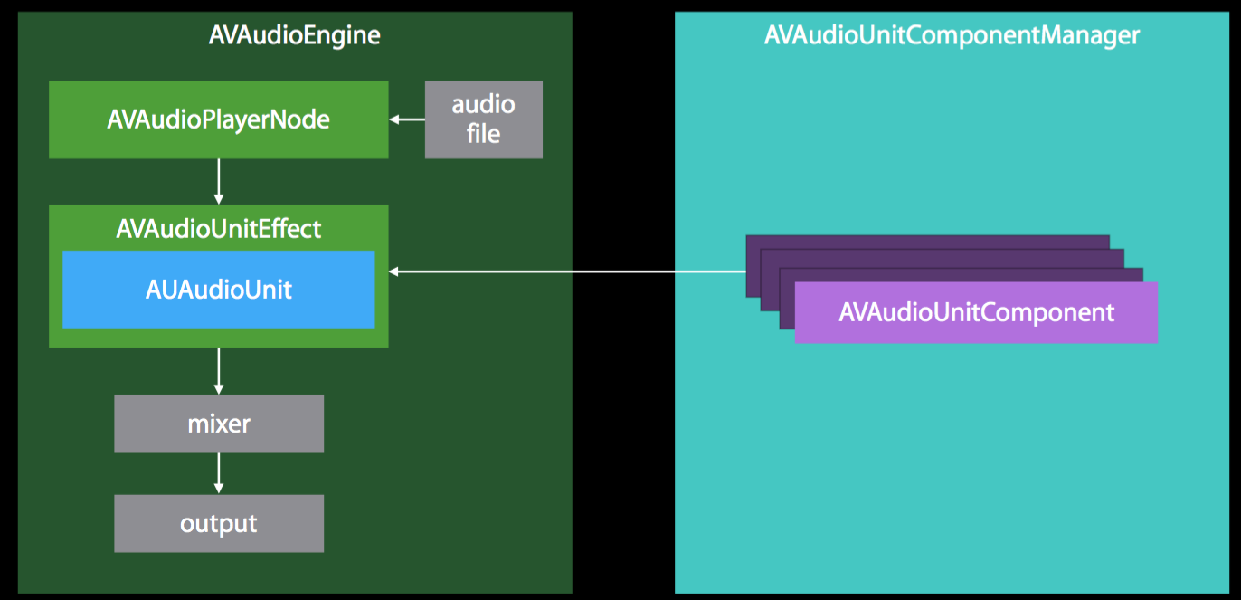
Component Manager
The Host loads an Audio Unit Component via the AV Audio Unit Component Manager
(introduced in iOS 9)

Slide 4
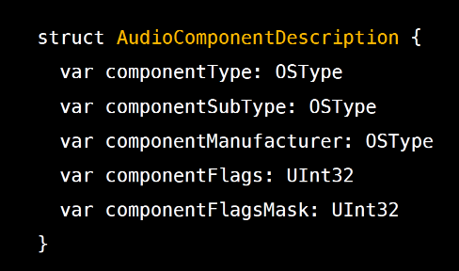
Component Manager (cont’d)
The manager searches based on the Audio Component Description
The Host creates one with wildcards (value of 0) for SubType and Manufacturer
If we want effects, pass kAudioUnitType_Effect to the Type
We get back an array of all effects in the iOS appex folder

Slide 5
Grabbing an Array of Audio Units
AudioComponentDescription anyEffect;
anyEffect.componentType = kAudioUnitType_Effect;
anyEffect.componentSubType = 0;
anyEffect.componentManufacturer = 0;
anyEffect.componentFlags = 0;
anyEffect.componentFlagsMask = 0;
AVAudioUnitComponent availableEffects = [AVAudioUnitComponentManager.sharedAudioUnitComponentManager componentsMatchingDescription:anyEffect];
Specify we want kAudioUnitType_Effect
Create a generic description (with wildcards)
Query for a list of available effects matching our description
Use this list to show to the user!

Slide 6
Instantiating an Audio Unit
+instantiateWithComponentDescription:desc options:[] completionHandler:^(AUAudioUnit *avAudioUnit, NSError *err){
self.effect = avAudioUnit;
[self.engine attachNode:self.effect];
[self.engine disconnectNodeInput:mainMixerNode];
[self.engine connect:self.player to:self.effect format:fmt];
[self.engine connect:self.effect to:mainMixerNode format:fmt];
self.presetList = self.effect.AUAudioUnit.factoryPresets;
... }
+instantiate... is called when a Component description is selected
A “class method” (denoted by +) that can be called directly on the class (not on an instance of the class)
Here (and often), used to create an object
Assign selected audio unit to self and attach to engine
Disconnect the input from the main mixer node
Attach the input to our new effect
Re-connect our new effect back to the main mixer node
Finally, grab a list of presets from the Audio Unit

